Slide 1
Evaluating Models Part 2
Comparing Models
Geoff Hulten

Slide 2
How good is a model?
Goal: predict how well a model will perform when deployed to customers
Use data:
Train
Validation (tune)
Test (generalization)
Assumption: All data is created independently by the same process.

Slide 3
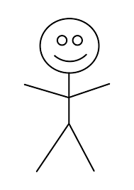
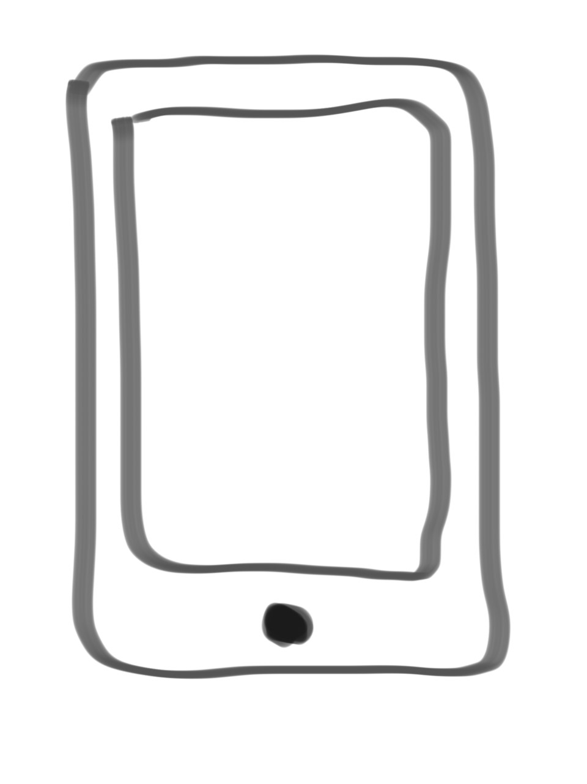
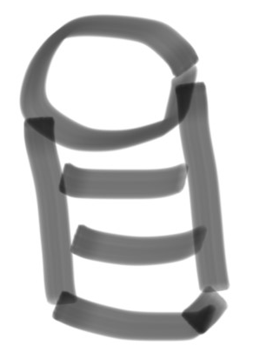
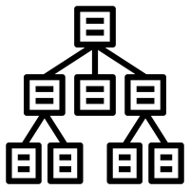


What does good mean?
Training Environment
Performance Environment
Build Model
Dataset
Training
Data
Deploy
Customer
Interaction
Testing
Data
Evaluate Model
Estimated
Accuracy
Actual
Accuracy
$${error}_{S}(h)$$
How do they
relate?
$${error}_{D}(h)$$

Slide 4
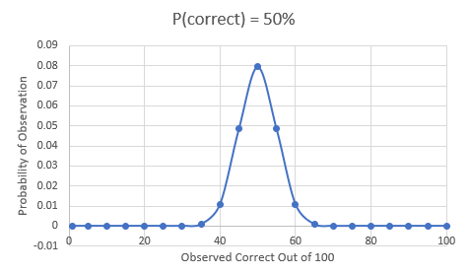
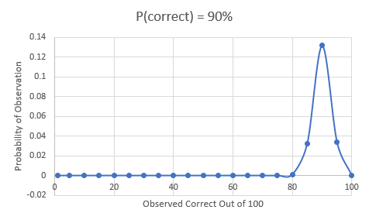
Binomial Distribution
Test n testing samples, how many correct?
Flip n coins, how many heads?

Slide 5
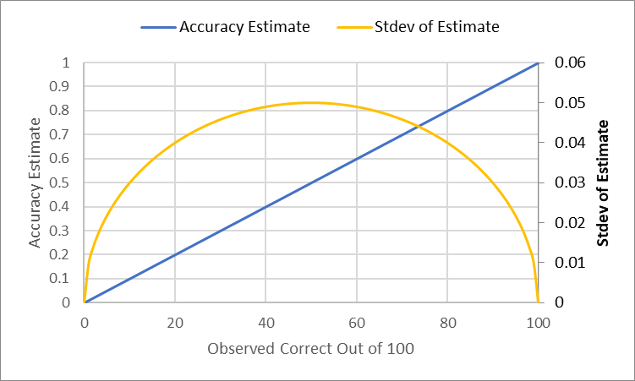
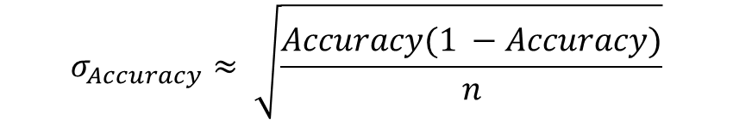

Estimating Accuracy
$$Accuracy= \frac{\# Correct}{n}$$
$$σ_{Accuracy}≈ \sqrt{\frac{Accuracy(1 −Accuracy)}{n}}$$

Slide 6
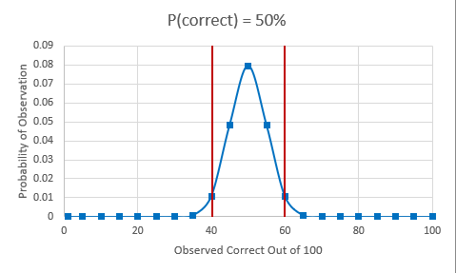
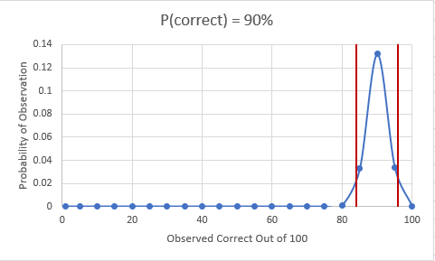
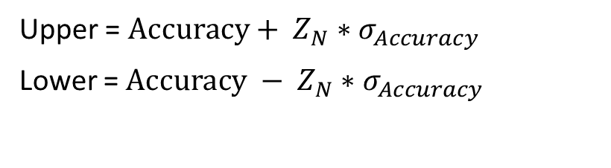
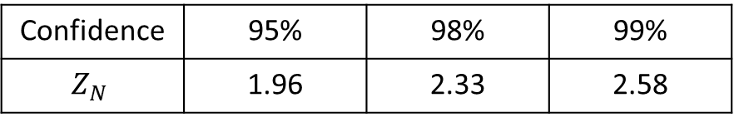
Confidence Intervals
Upper = $Accuracy+ Z_{N}∗σ_{Accuracy}$
Lower = $Accuracy − Z_{N}∗σ_{Accuracy}$
Confidence | 95% | 98% | 99%
$$Z_{N}$$ | 1.96 | 2.33 | 2.58

Slide 7
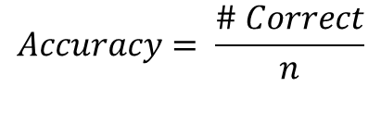
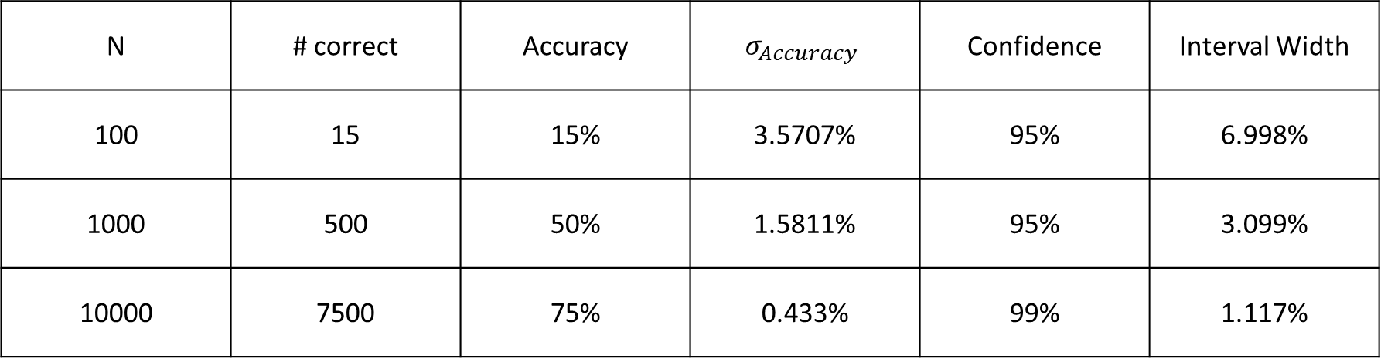
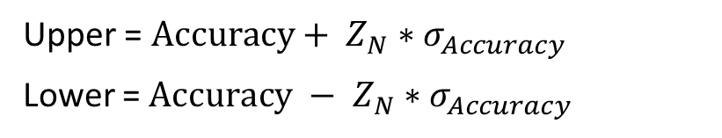
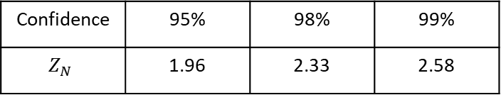
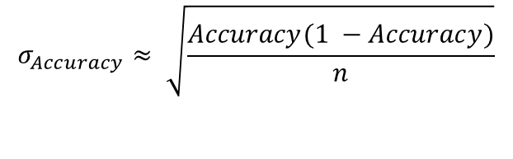
Confidence Interval Examples
Confidence | 95% | 98% | 99%
$$Z_{N}$$ | 1.96 | 2.33 | 2.58
$$σ_{Accuracy}≈ \sqrt{\frac{Accuracy(1 −Accuracy)}{n}}$$
$$Accuracy= \frac{\# Correct}{n}$$
Upper = $Accuracy+ Z_{N}∗σ_{Accuracy}$
Lower = $Accuracy − Z_{N}∗σ_{Accuracy}$
N | # correct | Accuracy | $$σ_{Accuracy}$$ | Confidence | Interval Width
100 | 15 | 15% | 3.5707% | 95% | 6.998%
1000 | 500 | 50% | 1.5811% | 95% | 3.099%
10000 | 7500 | 75% | 0.433% | 99% | 1.117%

Slide 8
Summary of Error Bounds
Use error bounds to know how certain you are of your error estimates
Use error bounds to estimate the worst case behavior

Slide 9
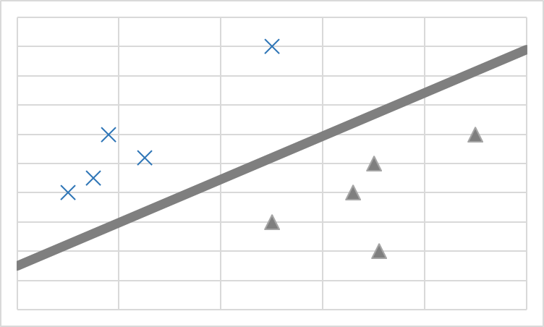




Comparing Models
Training Environment
Performance Environment
Build a New Model
Dataset
Training
Data
Deploy??
Customer
Interaction
Testing
Data
Evaluate Models
Actual
Accuracy
Estimated
Accuracies
$${error}_{S}(tree)$$
$${error}_{D}(tree)$$
Which will be
better?
$${error}_{S}(linear)$$
$${error}_{D}(linear)$$

Slide 10
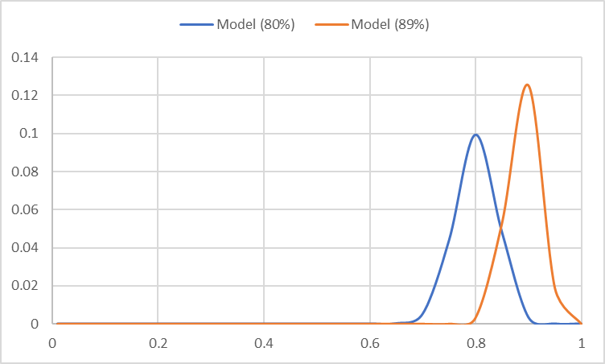
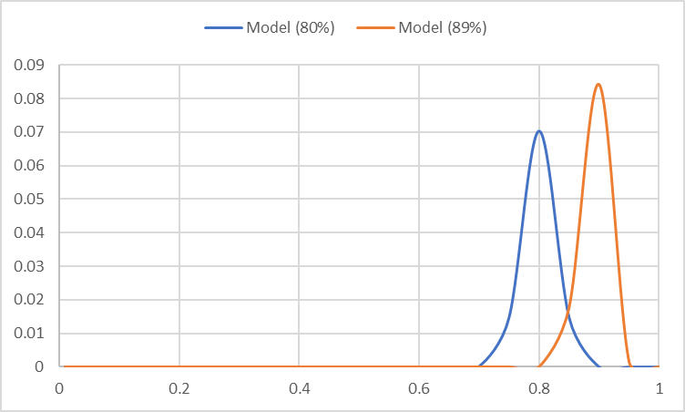
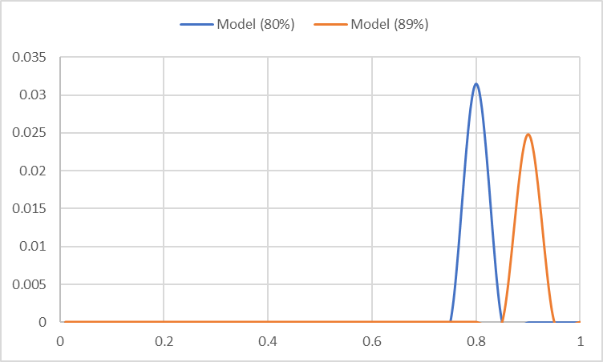
Comparing Models using Confidence Intervals
IF: Model1 – Bound > Model2 + Bound
Samples | Model(89%) – Bound | Model(80%) + Bound
100 | 82.9% | 87.8%
200 | 84.7% | 85.5%
1000 | 87.0% | 82.5%
95% Confidence Interval

Slide 11
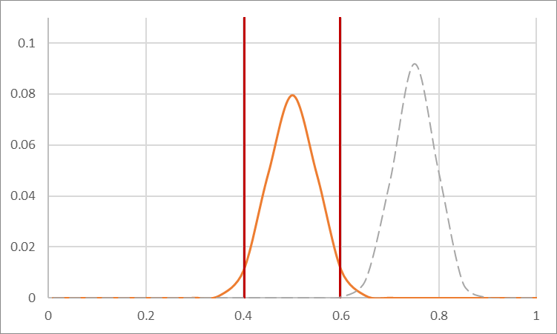
One Sided Bounds

Slide 12
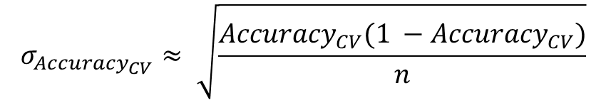
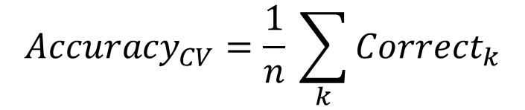
Cross Validation
Instead of dividing training data into two parts (train & validation).
Divide it into K parts and loop over them
Hold out one part for validation, train on remaining data
K = 1
K = 2
K = 3
K = 4
K = 5
Train on
Validate on
$${Accuracy}_{CV}=\frac{1}{n} \sum_{k}{{Correct}_{k}}$$
$$σ_{{Accuracy}_{CV}}≈ \sqrt{\frac{{Accuracy}_{CV}(1 −{Accuracy}_{CV})}{n}}$$

Slide 13
Cross Validation pseudo-code
totalCorrect = 0
for i in range(K):
(foldTrainX, foldTrainY) = GetAllDataExceptFold(trainX, trainY, i)
(foldValidationX, foldValidationY) = GetDataInFold(trainX, trainY, i)
# do feature engineering/selection on foldTrainX, foldTrainY
model.fit(foldTrainX, foldTrainY)
# featurize foldValidationX using the same method you used on foldTrainX
totalCorrect += CountCorrect(model.predict(foldValidationX), foldValidationY)
accuracy = totalCorrect / len(trainX)
upper = accuracy + z * sqrt( (accuracy * (1 - accuracy) ) / len(trainX) )
lower = accuracy - z * sqrt( (accuracy * (1 - accuracy) ) / len(trainX) )

Slide 14
When to use cross validation
K = 5 or 10 – k-fold cross validation
Do this in almost every situation
K = n – Leave out one cross validation
Do this if you have very little data
And be careful of:
Time series
Dependencies (e.g. spam campaigns)
Other violations of independence assumptions

Slide 15
Machine Learning Does LOTS of Tests
For each type of feature selection, for each parameter setting…
# Tests | P(all hold)
1 | .95
10 | .598
100 | .00592
1000 | 5.29E-23
# Tests | P(all hold)
1 | .999
10 | .990
100 | .9048
1000 | .3677
95% Bounds
99.9% Bounds

Slide 16
Summary
Always think about your measurements:
Independent test data
Think of statistical estimates instead of point estimates
Be suspicious of small gains
Get lots of data!

